Slide 1
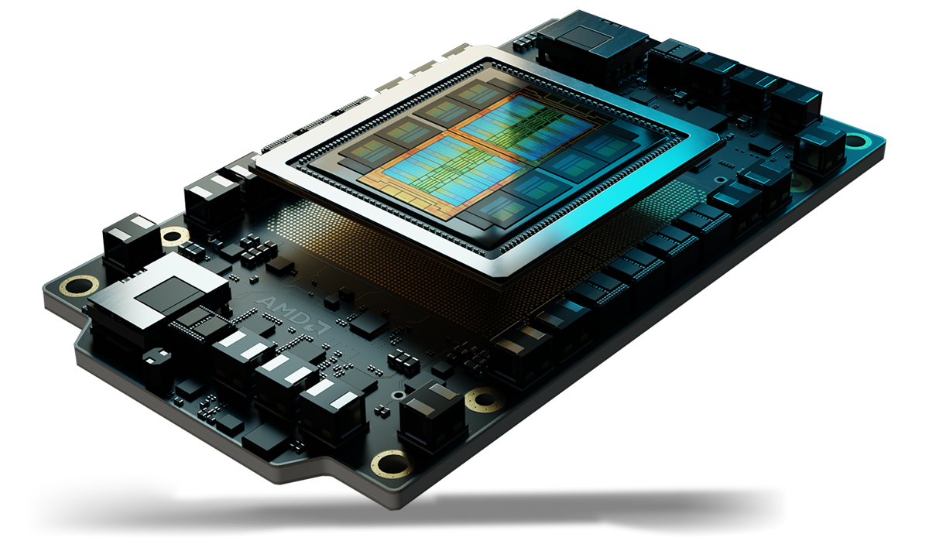
Performance of QAOA for MIS
Implementation on Pennylane
Simulation on AMD clusters

Slide 2


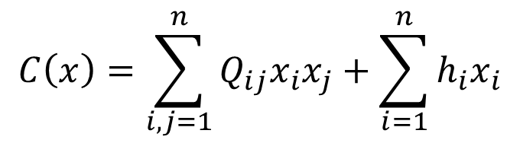
1
Presentation of the problem
Combinatorial Problems
Optimization problem: minimize a cost function $C$ in the space $S$ of allowed configurations
QUBO formulation:
$$\min_{x∈S}{C\left(x\right)}$$
Generally, for graphs, $x=(x_{1},…,x_{n})$ represents configuration of nodes or edges, and $x_{i}∈\left\{0,1\right\}$
$$C\left(x\right)=\sum_{i,j=1}^{n}{Q_{ij}x_{i}x_{j}}+\sum_{i=1}^{n}{h_{i}x_{i}}$$

Slide 3

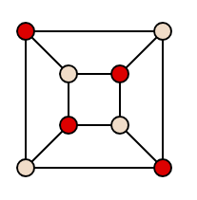
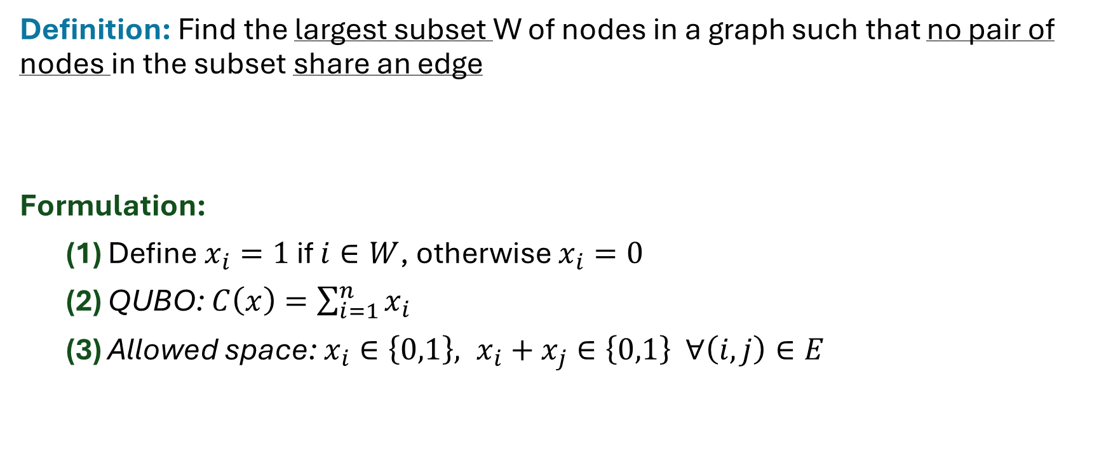
1
Presentation of the problem
Example: MIS (Maximum Independent Set)
Definition: Find the largest subset W of nodes in a graph such that no pair of nodes in the subset share an edge
Formulation:
(1) Define $x_{i}=1$ if $i∈W$, otherwise $x_{i}=0$
(2) QUBO: $C\left(x\right)=\sum_{i=1}^{n}{x_{i}}$
(3) Allowed space: $x_{i}∈\left\{0,1\right\}, x_{i}+x_{j}∈\left\{0,1\right\} ∀\left(i,j\right)∈E$
RM Karp, 1972: MIS is NP−complete

Slide 4

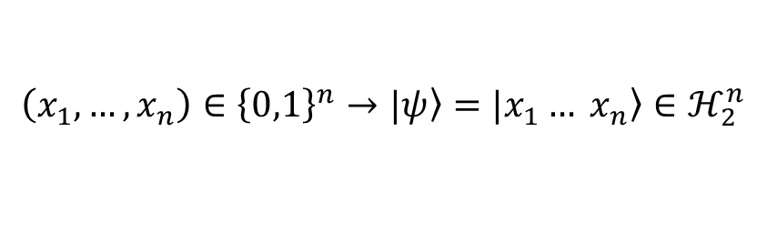
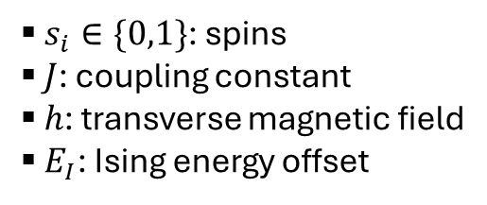
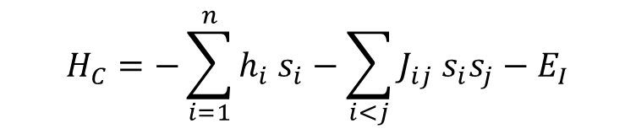
1
Presentation of the problem
Qubit mapping of the problem
Encoding of Boolean variables into qubits
Ising Hamiltonian:
Goal: find the ground state of $H_{C}$
Fahri et al., 2000: Adiabatic evolution
3-SAT problem
$$\left(x_{1},…,x_{n}\right)∈{\left\{0,1\right\}}^{n}→|\left.ψ\right\rangle =\left.|x_{1}… x_{n}\right\rangle ∈ℋ_{2}^{n}$$
$$H_{C}=−\sum_{i=1}^{n}{h_{i} s_{i}}−\sum_{i<j}{J_{ij} s_{i}s_{j}}−E_{I}$$
A. Lucas, 2014: Insing formulation of many NP problems
$s_{i}∈\{0,1\}$: spins
$J$: coupling constant
$h$: transverse magnetic field
$E_{I}$: Ising energy offset

Slide 5
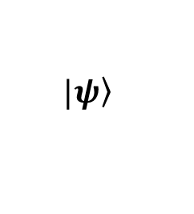






1
Presentation of the problem
Solution: QAOA (Quantum Approximate Optimization Algorithm)
Inspired by quantum annealing
Fahri et al., 2014
$$p×$$
Cost layer
$$H_{C}$$
Mixer layer
$$H_{M}$$
Cost layer
$$H_{C}$$
Mixer layer
$$H_{M}$$
Measurement
$$\left.|ψ\right\rangle$$
…
$$N×$$

Slide 6
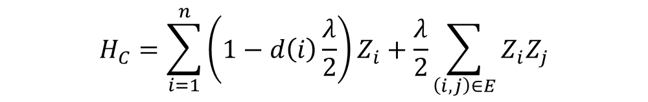

1
Presentation of the problem
QAOA for MIS
A. Lucas, 2014
Ising Hamiltonian for MIS (penalizer $λ>1$):
$$H_{C}=\sum_{i=1}^{n}{\left(1−d\left(i\right)\frac{λ}{2}\right)Z_{i}}+\frac{λ}{2}\sum_{\left(i,j\right)∈E}{Z_{i}Z_{j}}$$
If two nodes in 𝑊 are connected, $λ>1$ ensures that keeping both is suboptimal compared to removing one

Slide 7
1
Presentation of the problem
Caveats of QVAs
Local minima
Barren plateaus

Slide 8
Standard QAOA
2
QAOA methods

Slide 9
Constrained QAOA
2
QAOA methods

Slide 10
Warm start (WS-QAOA)
2
QAOA methods

Slide 11
Multi angle (ma-QAOA)
2
QAOA methods

Slide 12
Expressive (XQAOA)
2
QAOA methods

Slide 13
Recursive (RQAOA)
2
QAOA methods

Slide 14
Parameter transfer
2
QAOA methods
INTERP:
FOURIER:

Slide 15
Questions to study
2
QAOA methods
Does warm start help/hurt trainability (Barren plateau proneness) + Compatibility of warm starting with parameter transfer
Accuracy and Barren proneness of standard / ma / X for same number of parameters
RQAOA: Compare accuracy and Barren plateaux of RQAOA vs QAOA for same computational cost. See if the advantages of RQAOA with respect to QAOA persist at large depth (Bravyi et al.)

Slide 16
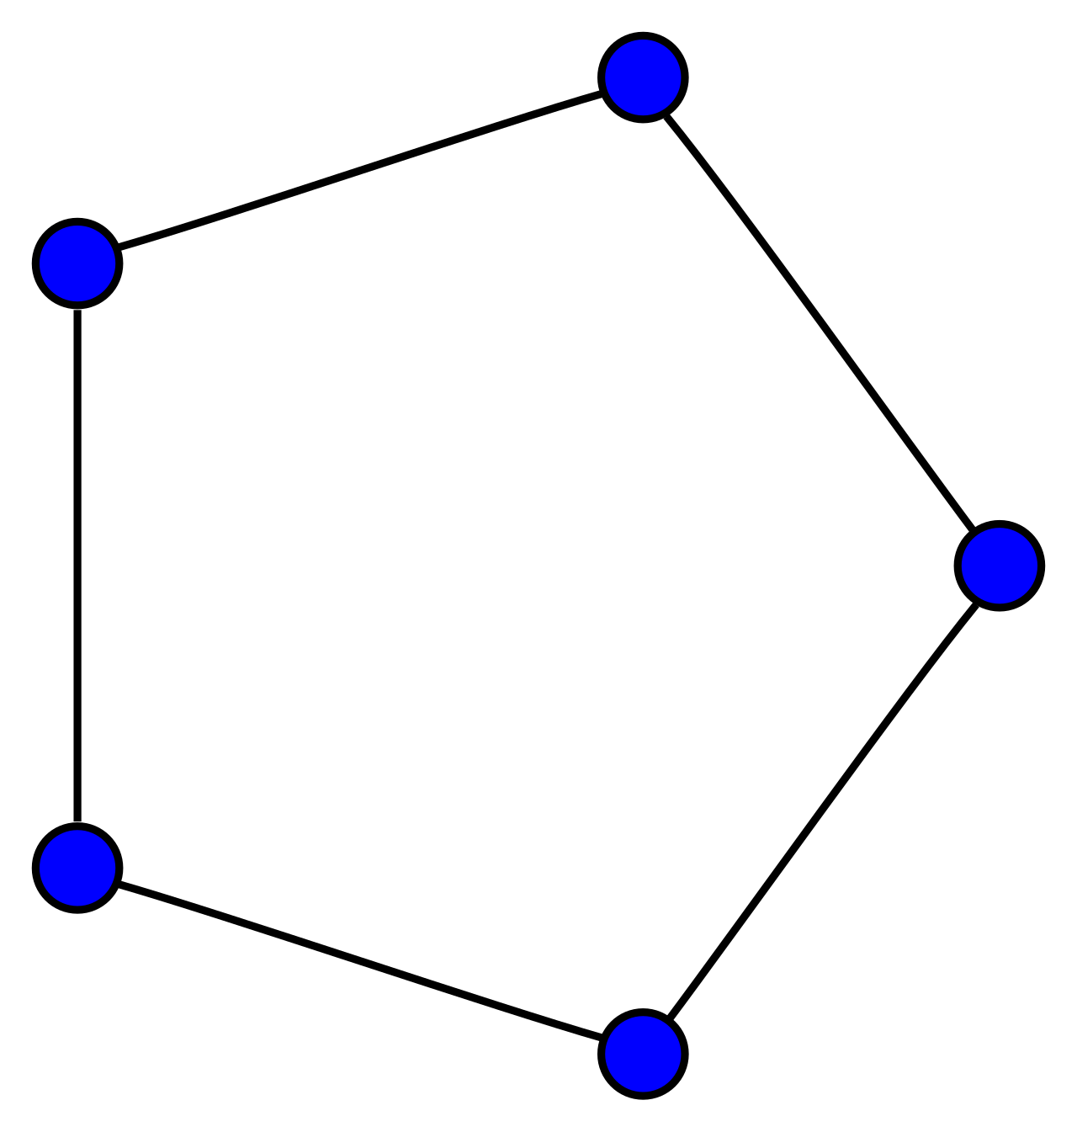
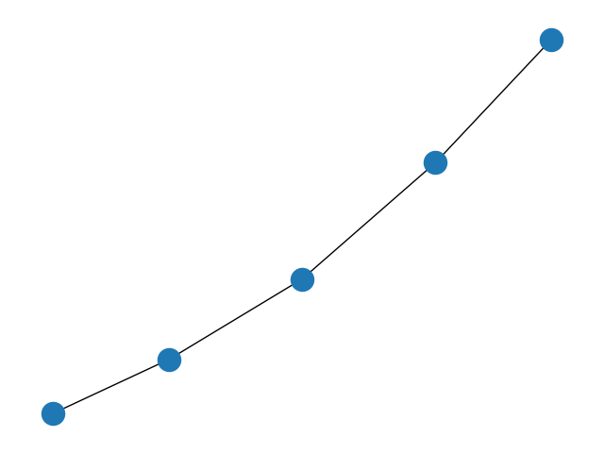
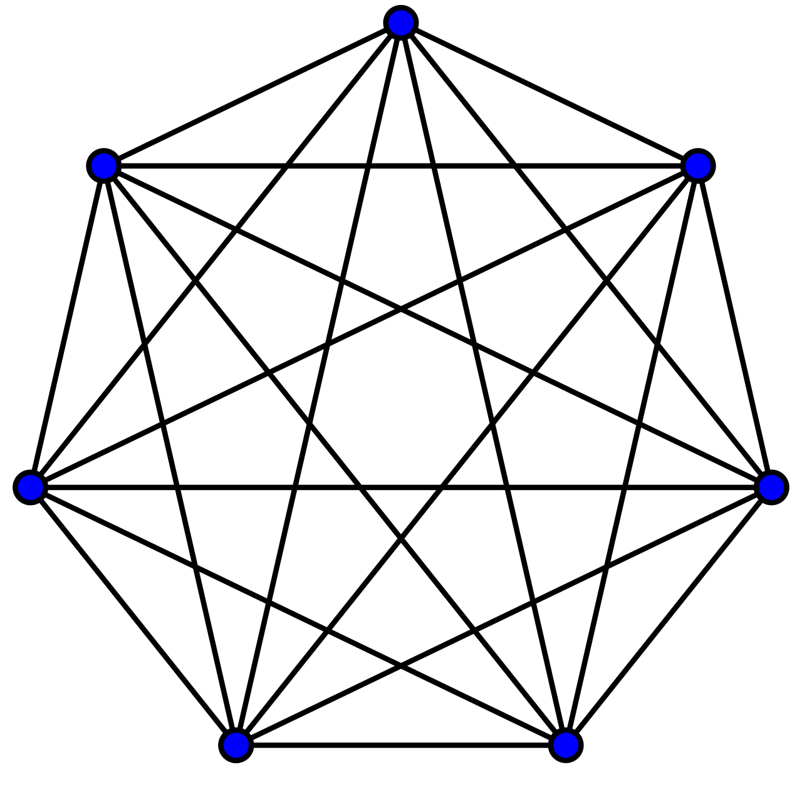
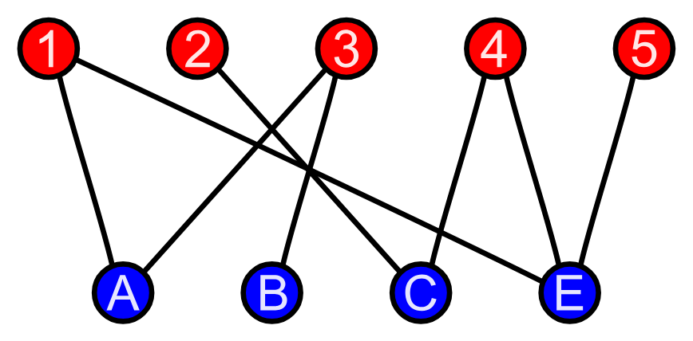

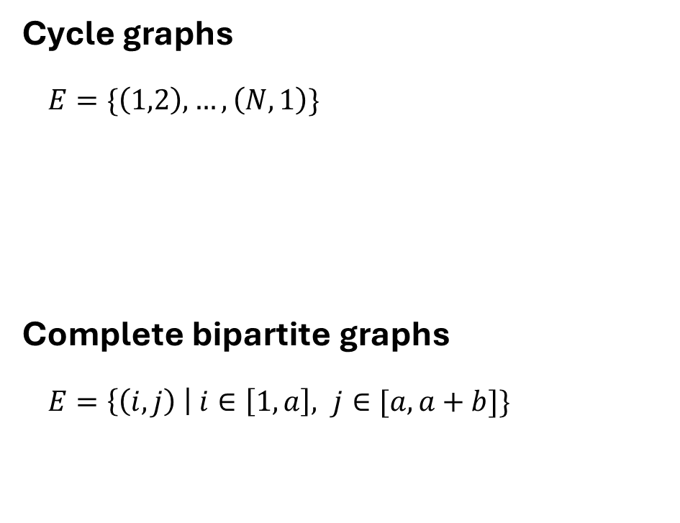
Graph classes studied (deterministic)
3
Problem variables
Path graphs
$E=\{\left(1,2\right),…,\left(N−1,N\right)\}$
Complete graphs
$E=\left\{\left(i, j\right) \right| i<j\}$
Cycle graphs
$E=\{\left(1,2\right),…,\left(N,1\right)\}$
Complete bipartite graphs
$E=\left\{\left(i, j\right) \right| i∈\left[1,a\right], j∈[a, a+b]\}$
nx.path_graph(N)
nx.circulant_graph(N)
nx.complete_graph(N)

Slide 17


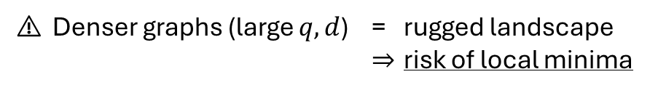
Graph classes studied (random)
3
Problem variables
Random Gilbert
$∀ i<j$, the edge $(i,j)$ exits with probability $q$
Expected number of nodes: $\frac{N\left(N−1\right)}{2}⋅q$
Expected degree of one node: $\frac{\left(N−1\right)}{2}⋅q$
Random d-regular
Uniform sampling of a $d$-regular graph
Number of nodes: $N⋅d$
Degree of one node: $d$
Focus on 3-regular
nx.fast_gnp_random_graph(N, q)
nx.random_regular_graph(d, N)
Gilbert E.N, 1959
Kim and Vu, 2003
⚠ Denser graphs (large $q,d$) = rugged landscape
⇒ risk of local minima

Slide 18
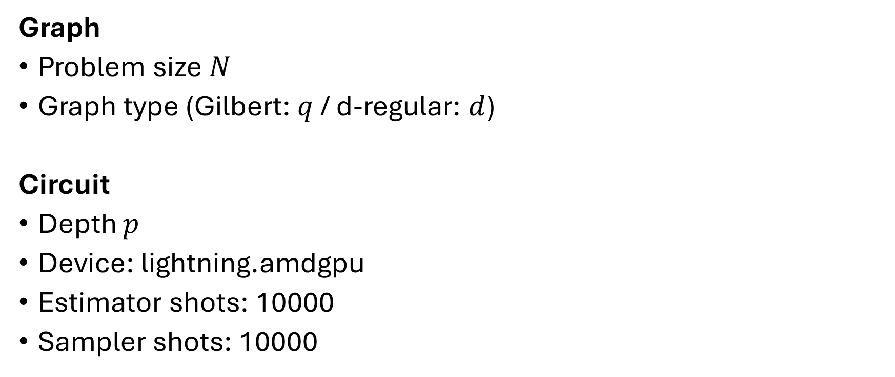
The circuit
3
Problem variables
Graph
Problem size $N$
Graph type (Gilbert: $q$ / d-regular: $d$)
Circuit
Depth $p$
Device: lightning.amdgpu
Estimator shots: 10000
Sampler shots: 10000

Slide 19
The optimizer
3
Problem variables
AdamOptimizer
GradientDescentOptimizer
SPSA
L-BFGS-B
Optimization steps: 300

Slide 20
Comparison metrics
4
Comparison metrics
Accuracy
A1: Approximation ratio
A2: Exact success probability
Barren plateau proneness
B1: Variance of the gradient with respect to N and p
B2: Landscape ruggedness around starting/optimized parameter set

